Slide 1
II
I
III
IV
Behind the scenes
Conclusion
Introduction
The Website
Welcome
Who are we and what is our purpose?
A presentation of our website, SDG’s Learning
A deep dive into key features of our project.

Slide 2
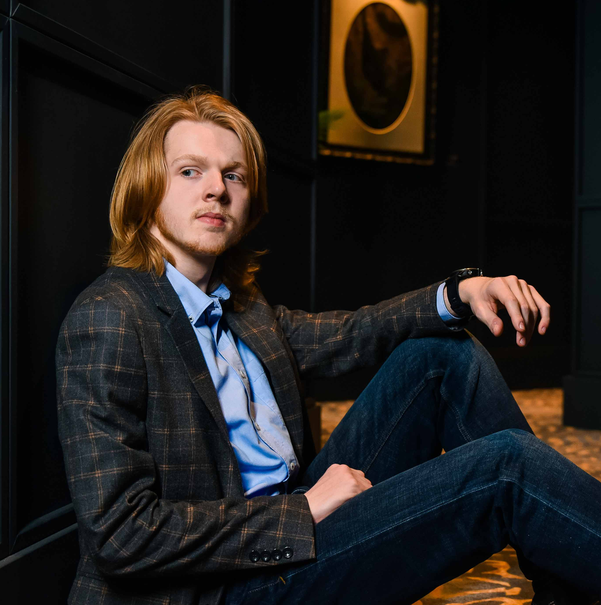

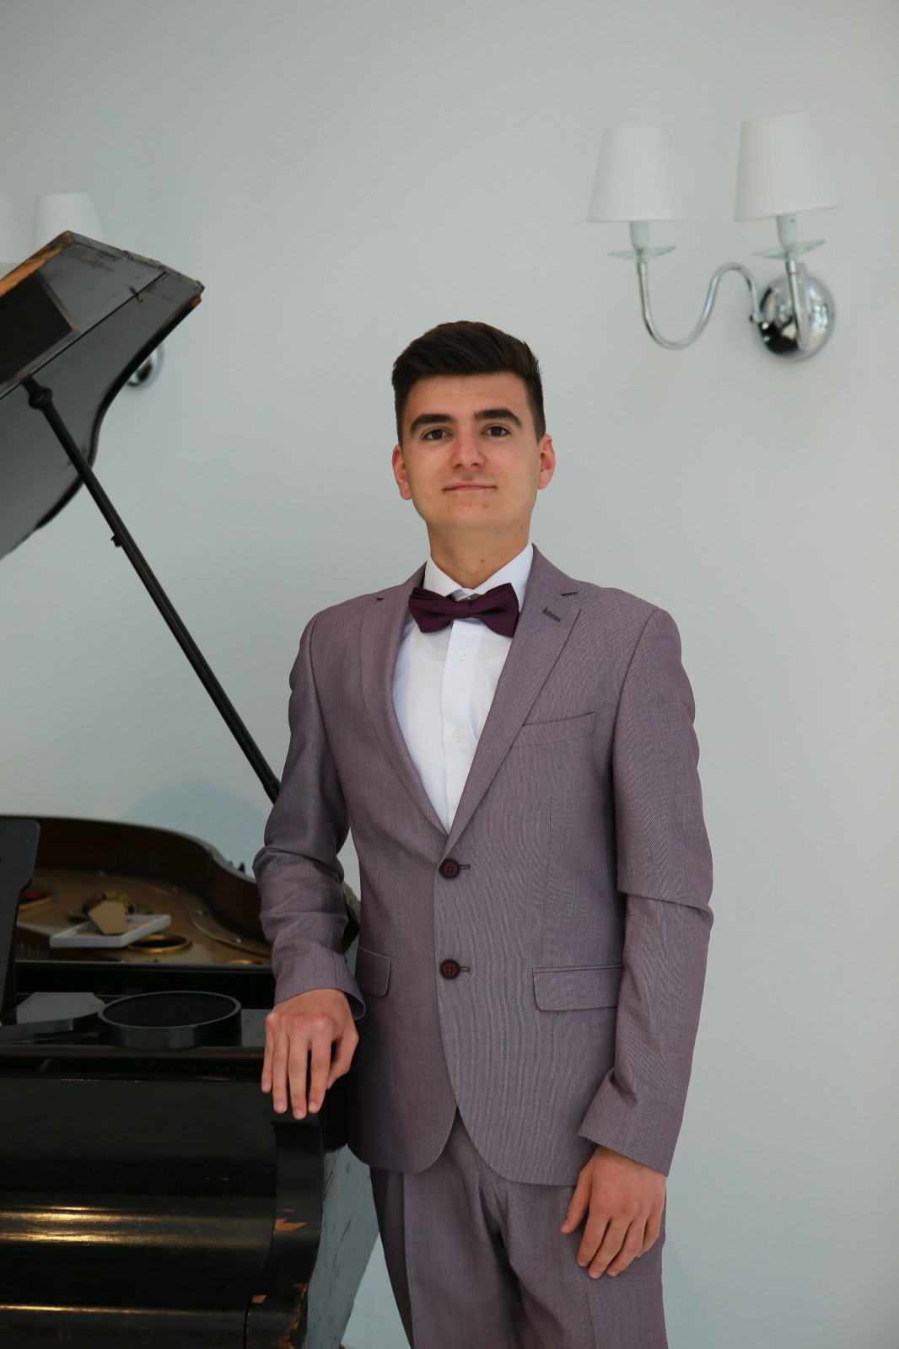
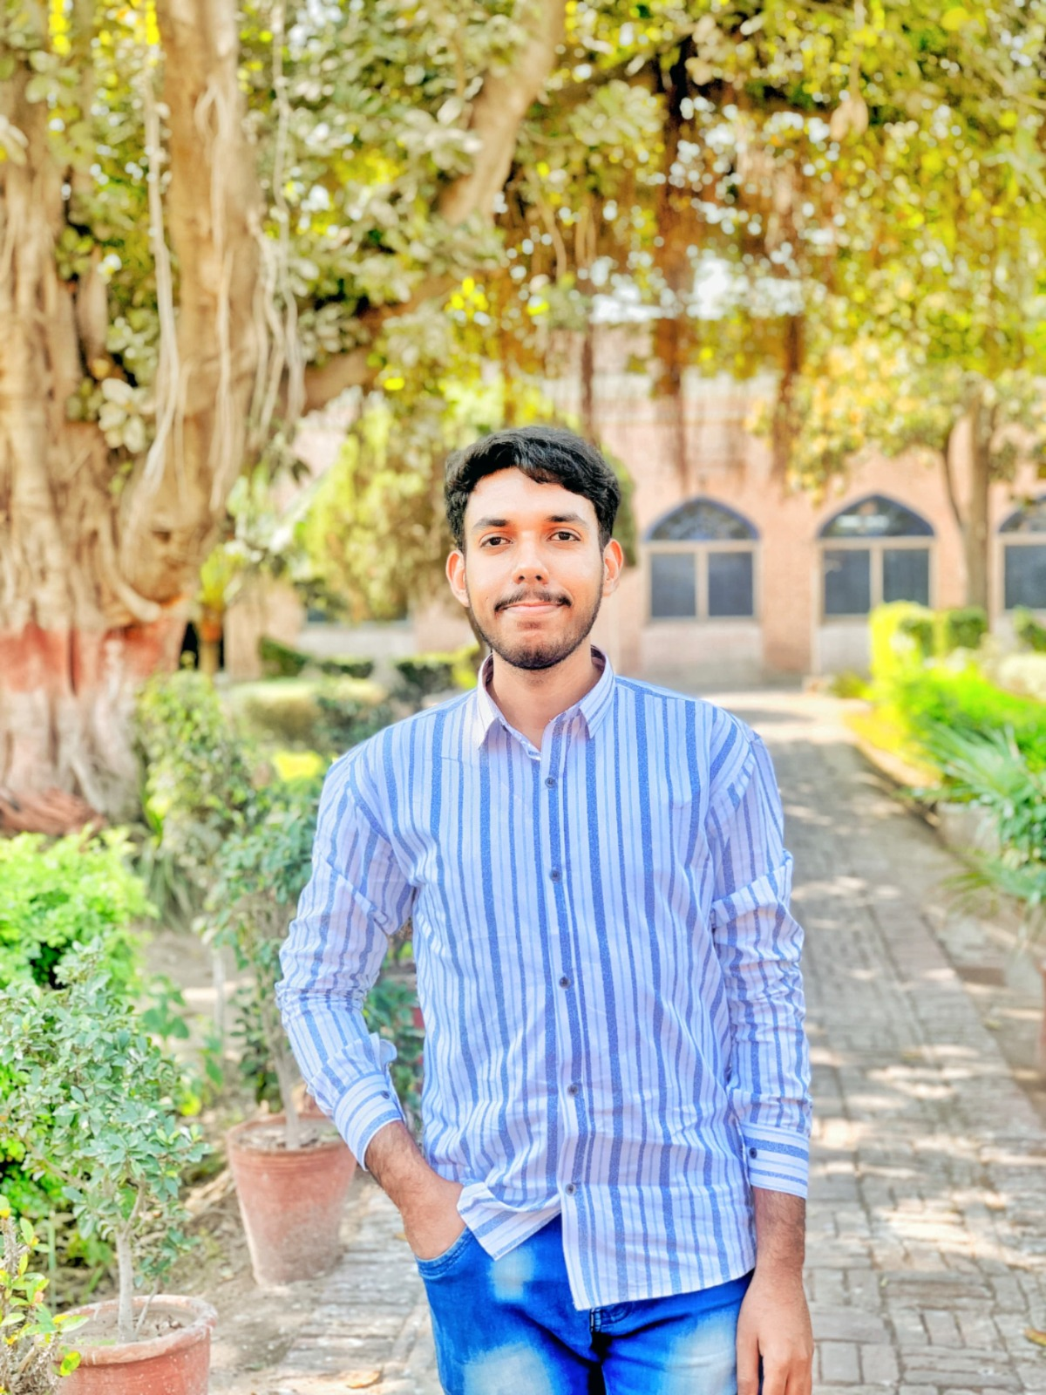

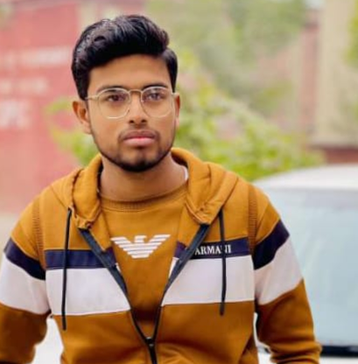
I
II
III
IV
Introduction
The Website
Behind the scenes
Conclusion
Welcome
Who are we and what is our purpose?
A presentation of our website, SDG’s Learning
A deep dive into key features of our project.
This is
4Green Horizons

Slide 3
III
I
IV
II
Bacriu Iuliana Maria
Front-end
Abdullah Siddique Back-end
Behind the scenes
Introduction
This is
4Green Horizons
Conclusion
The Website
Nagy David Csaba
Front-end
Muhammad Huzaifa
Back-end
Who are we and what is our purpose?
A presentation of our website, SDG’s Learning
A deep dive into key features of our project.
Ionescu Daniel Nicolae
Front-end
Hateem Hussain
Back-end

Slide 4
I
III
IV
II
Our purpose is to spread awareness amongst people regarding global issues and to educate them with various activities appealing to old and young alike.
Behind the scenes
Conclusion
The Website
A presentation of our website, SDG’s Learning
A deep dive into key features of our project.

Slide 5
I
II
III
IV
Introduction
The Website
Behind the scenes
Conclusion
Who are we and what is our purpose?
A presentation of our website, SDG’s Learning
A deep dive into key features of our project.

Slide 6
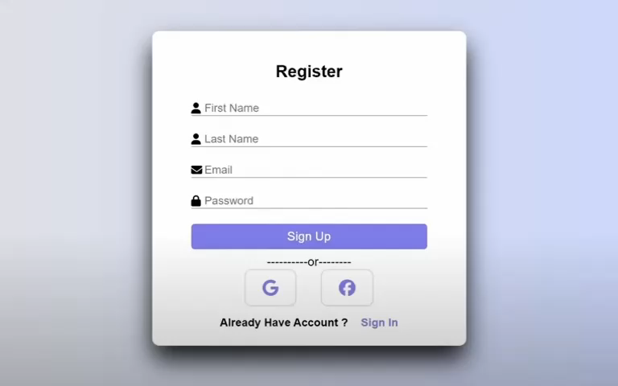
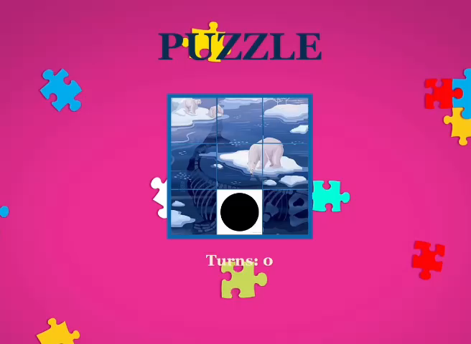
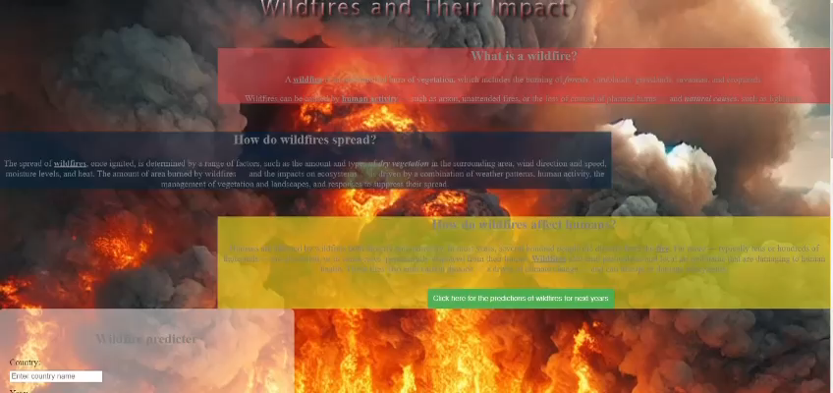
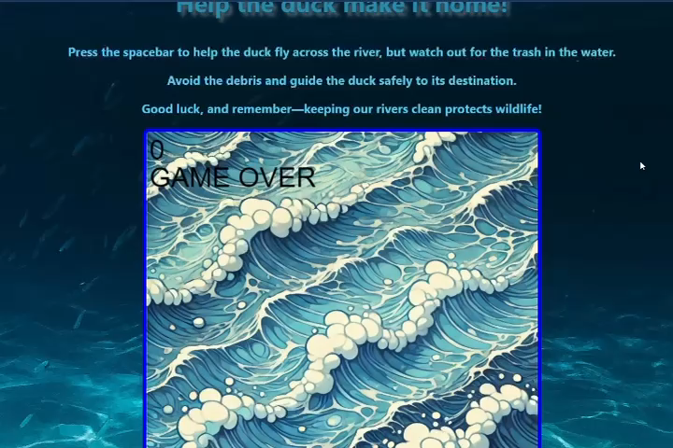
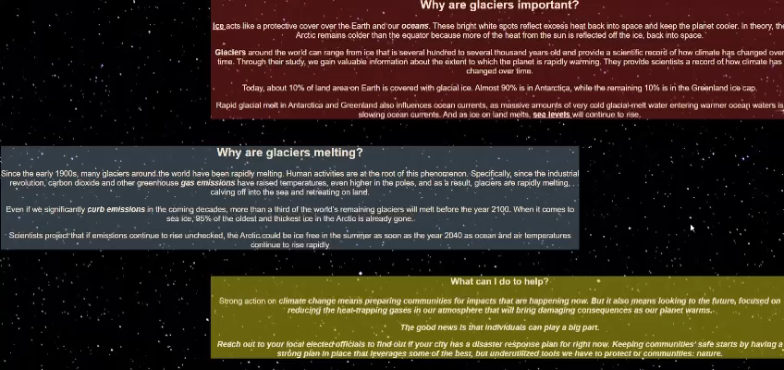
II
I
Users can create an account and scroll through various options.
IV
III
Our website offers many activities such as:
- minigames where the user receives informative messages;
- Interactive maps the user can look at and learn at the same time;
Conclusion
The Website
Introduction
Behind the scenes
A presentation of our website, SDG’s Learning
Who are we and what is our purpose?
Slide puzzle
A deep dive into key features of our project.
A map about the melting of the ice caps
Flappy duck
A map of the wildfires around the globe

Slide 7
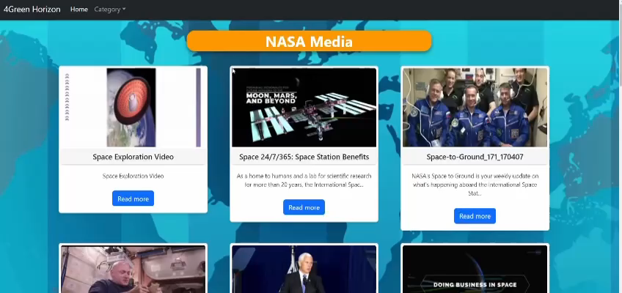
II
I
IV
III
We also offer a news section where users can be up to date with important events happening all around the globe.
Conclusion
Introduction
Behind the scenes
Who are we and what is our purpose?
A deep dive into key features of our project.

Slide 8
I
II
III
IV
Introduction
The Website
Behind the scenes
Conclusion
Who are we and what is our purpose?
A presentation of our website, SDG’s Learning
A deep dive into key features of our project.

Slide 9
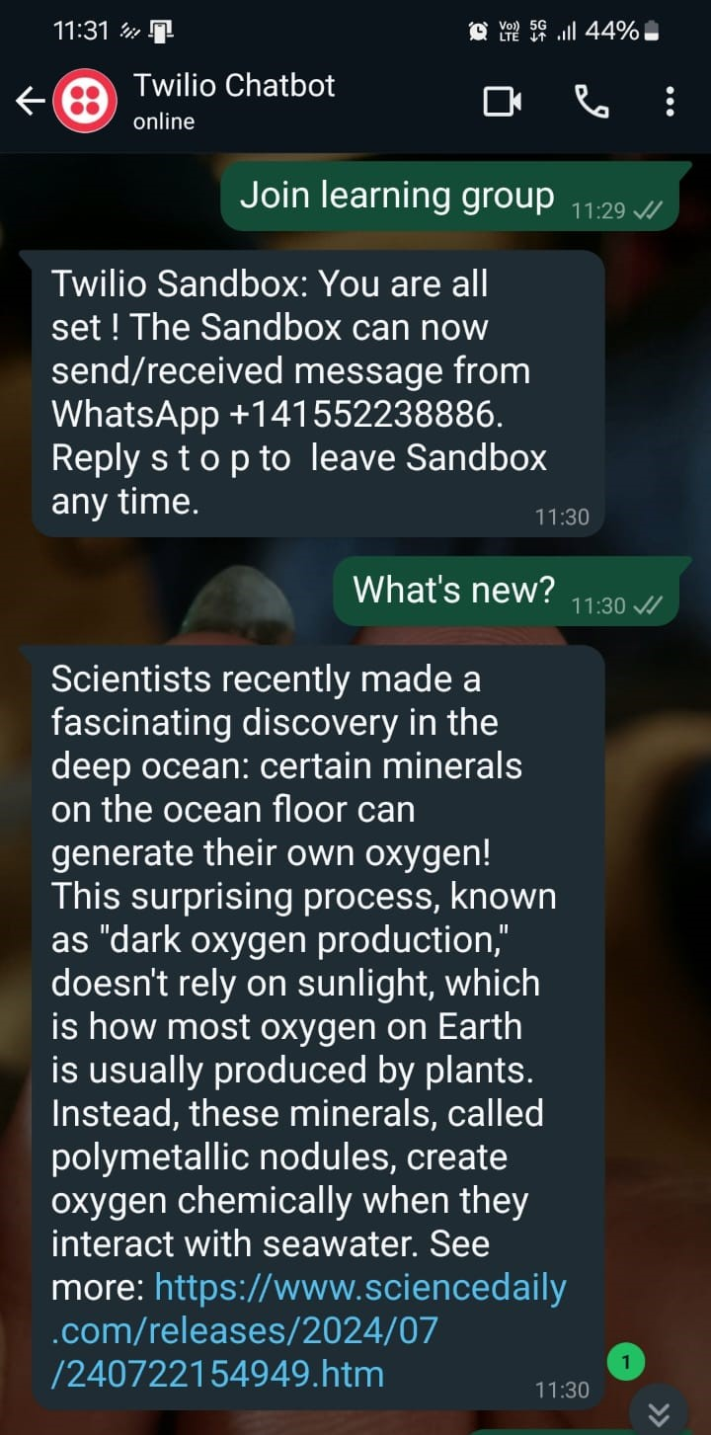
III
I
IV
II
Introducing our new WhatsApp Chatbot, Twilio. A personal helper to make it easier for the user to learn something new everyday.
Conclusion
Behind the scenes
Introduction
The Website
We have also created a machine learning model using linear regression to predict annual wildfire areas in square kilometers per country. By analyzing historical data on fires and climate, it can identify trends and predict high-risk areas, helping allocate firefighting resources effectively and alerting communities at risk. Linear regression is effective here due to its simplicity and ability to show how factors like temperature impact fire spread, offering a clear and actionable insight for decision-makers.
Who are we and what is our purpose?
A presentation of our website, SDG’s Learning
A deep dive into key features of our project.

Slide 10


I
II
III
IV
Behind the scenes
We hope our website and ideas will be able to raise awareness about global issues and that we may have a better future together.
Introduction
The Website
Conclusion
Who are we and what is our purpose?
A presentation of our website, SDG’s Learning
A deep dive into key features of our project.
Sdg_Learning_Community
sdglearningcommunity

Slide 11
I
IV
II
III
Conclusion
Behind the scenes
Thank you for your attention.
Introduction
The Website
We hope our website and ideas will be able to raise awareness about global issues and that we may have a better future together.
Who are we and what is our purpose?
A presentation of our website, SDG’s Learning
A deep dive into key features of our project.
Sdg_Learning_Community
sdglearningcommunity

Slide 12
I
II
IV
III
Conclusion
Behind the scenes
Thank you for your attention.
Introduction
The Website
Who are we and what is our purpose?
A presentation of our website, SDG’s Learning
A deep dive into key features of our project.

